Slide 1
CLASSIFICATION ALGORITHMS Instance Based Learning K-Nearest Neighbour

Slide 2
Outline
Eager vs. Lazy Learning
Instance Based Learning
K-Nearest Neighbor Algorithm
Nearest Neighbor Approach
Basic k-Nearest Neighbor Classification
Distance Formula
k-NN Variations
Picking K
k-NN Time Complexity
Discussion: Advantages / Disadvantages
Comparison with Other Algorithms

Slide 3


Eager vs. Lazy Learning
Eager learning (eg. Decision trees, SVM, NN): Given a set of training set, constructs a classification model before receiving new (e.g., test) data to classify.
Lazy learning (e.g., instance-based learning): Simply stores training data and waits until it is given a test tuple.

Slide 4
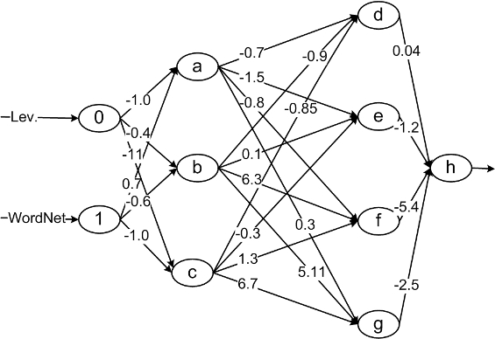
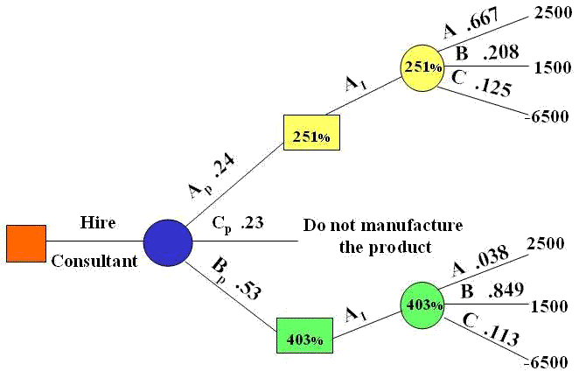
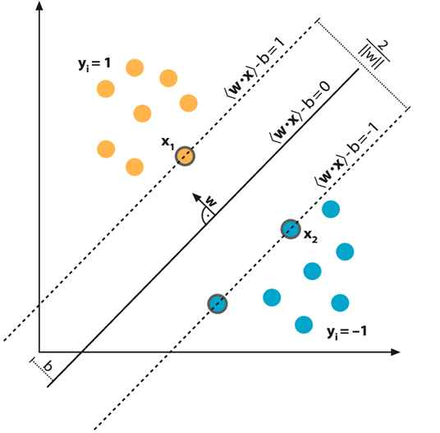
Eager Learning
Given a set of training set, constructs a classification model before receiving new (e.g., test) data to classify.
Example models:
Decision tree Neural Network Support Vector Machine

Slide 5
Lazy Learning
Simply stores training data and waits until it is given a test tuple.
Less time in training but more time in predicting

Slide 6
Lazy Learning
Advantages
can simultaneously solve multiple problems
deal successfully with changes in the problem domain
Disadvantages
large space requirement to store the entire training dataset
particularly noisy training data increases the case base unnecessarily, because no abstraction is made during the training phase
usually slower to evaluate, though this is coupled with a faster training phase.

Slide 7
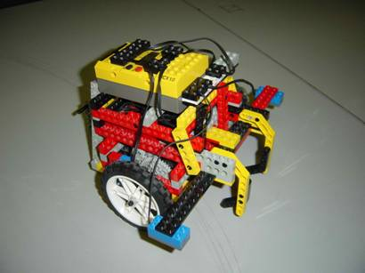
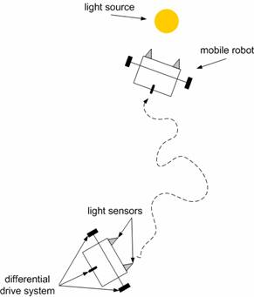
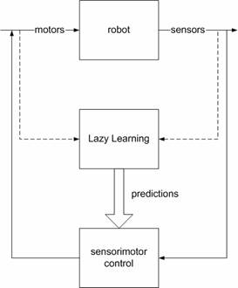
Example Lazy Learning Study
Learning of a Control Task for a LEGO Mindstorms Mobile Robot

Slide 8
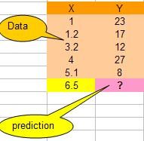
Lazy Learner: Instance-Based Methods
Instance-based learning is a kind of lazy learning.
Instance-based learning:
Store training examples and delay the processing (“lazy evaluation”) until a new instance must be classified.

Slide 9
Instance Based Learning
In machine learning, instance-based learning or memory-based learning is a family of learning algorithms that, instead of performing explicit generalization, compare new problem instances with instances seen in training, which have been stored in memory.
This means that the hypothesis complexity can grow with the data.

Slide 10
Instance Based Learning
Typical approaches
k-Nearest Neighbor
Instances represented as points in a Euclidean space.
Weighted regression
Constructs local approximation
Case-based reasoning
The process of solving new problems based on the solutions of similar past problems.

Slide 11
K-Nearest Neighbor

Slide 12
K-Nearest Neighbor
A simple example of an instance-based learning algorithm is the k-nearest neighbor algorithm.
Features
All instances correspond to points in an n-dimensional Euclidean space
Classification is delayed till a new instance arrives
Classification done by comparing feature vectors of the different points
Target function may be discrete or real-valued
_
_
_
.
+
_
+
_
x_{q}
+
_
+

Slide 13
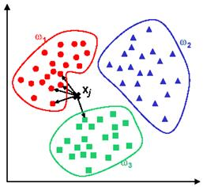
K-Nearest Neighbor Classification
Simply store all of the examples in the training set.
When desiring to generalize on a new instance, measure the distance from the new instance to one or more stored instances which vote to decide the class of the new instance.

Slide 14
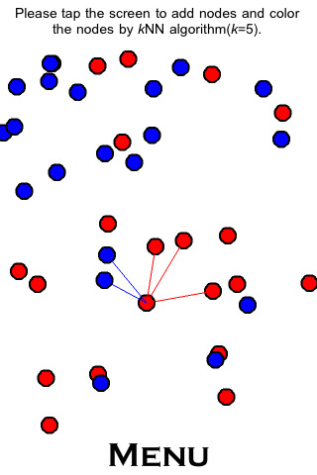
k-Nearest Neighbor
Naturally supports real valued attributes
Typically use Euclidean distance
The output class for the query instance is set to the most common class of its k nearest neighbors
where δ(x,y) = 1 if x = y, else 0.

Slide 15
k-Nearest Neighbor
All instances correspond to points in the n-D space
The nearest neighbor are defined in terms of Euclidean distance, dist(X₁, X₂)
X
Stored training set patterns
X Input pattern for classification
--- Euclidean distance measure to the nearest three patterns

Slide 16
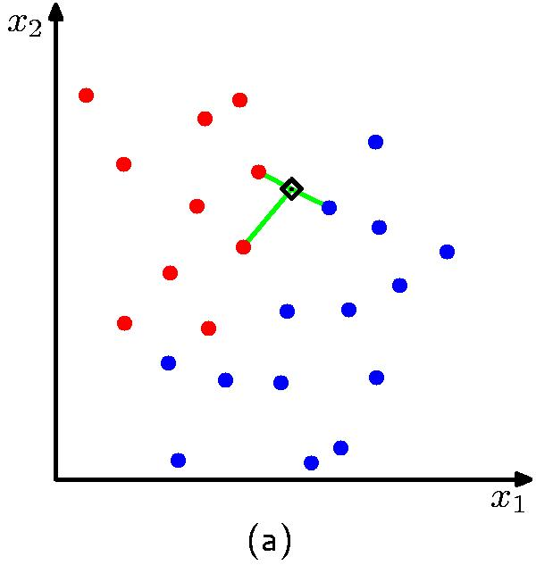
k-Nearest Neighbor
For a given instance T, get the top k dataset instances that are “nearest” to T
Select a reasonable distance measure
Inspect the category of these k instances, choose the category C that represent the most instances
Conclude that T belongs to category C

Slide 17
Example Application Document Classification (k=6)
P(science| )?
Government
Science
Arts

Slide 18
Examples

Slide 19
Training data
K-Nearest Neighbor (k-NN) Example
Test instance
Notes:
OK here is the data.
Now let’s calculate the distance between this example and all the others.
Do on the overhead projector using pen.
So distance between 8 and 7 is
SQRT ( 0 + 1 + 25 + 1) = SQRT(27)= 5.2
THINK a moment. DOES this seem sensible to you?
Isn’t the calculation being skewed by the large values of the rectangle data relative to the other data?

Slide 20
Keep data in normalised form
One way to normalise the data a_{r}(x) to a´_{r}(x) is
Notes:
The test instance would have to be normalised (using the training data average and standard deviation)

Slide 21
Normalised training data
K-Nearest Neighbor (K-NN) Example
Test instance

Slide 22
K-Nearest Neighbor (K-NN) Example
Classification
1-NN Yes
3-NN Yes
5-NN No
7-NN No
Notes:
Here are the distances
Before clicking to reveal classification table
So what would a 1-nearest neighbour classifier predict for the test instance?
What would a 3-nearest neighbour predict?

Slide 23
Choosing K

Slide 24
Choosing k
Value of k
Larger k increases confidence in prediction
Note that if k is too large, decision may be skewed
k greater than 1 is more noise resistant, but a very large k would lead to less accuracy as less relevant neighbors have more influence (common values: k=3, k=5)
Choose k by Cross Validation (trying different values for a task)

Slide 25
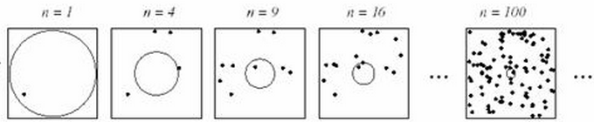
Choosing k
Density is important

Slide 26
Discussion on k-NN

Slide 27
k-NN Time Complexity
Suppose there are m instances and n features in the dataset
Nearest neighbor algorithm requires computing m distances
Each distance computation involves scanning through each feature value
Running time complexity is proportional to m X n

Slide 28
Advantages
Learning is very simple (fast learning)
Robust to noisy data by averaging k-nearest neighbors
Highly effective for complex target functions
Target function for a whole space may be described as a combination of less complex local approximations
Scales well with large number of classes
Don’t need to train n classifiers for n classes
In most cases it’s more accurate than NB or Rocchio
Issues with distance with very high dimensionality tasks.
Easy to understand which facilitates implementation and modification.

Slide 29
Disadvantages
Classification is time consuming
Have to calculate the distance of the test case from all training cases
Real-valued prediction for a given unknown tuple
Memory intensive: require significant storage
Classes can influence each other
Small changes to one class can have ripple effect
the accuracy of the algorithm degrades with increase of irrelevant attributes.
Note: Some models index the data or reduce the instances stored to enhance efficiency.

Slide 30
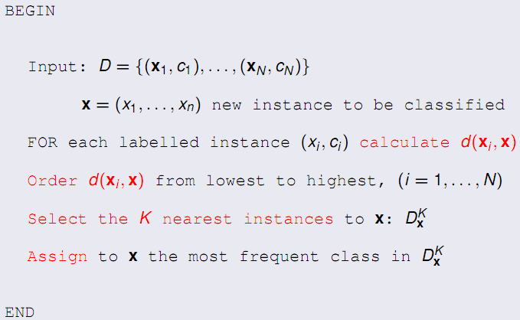
Pseudo Code

Slide 31
k-Nearest-Neighbor Algorithm
The case of discrete set of classes.
Take the instance x to be classified
Find k nearest neighbors of x in the training data.
Determine the class c of the majority of the instances among the k nearest neighbors.
Return the class c as the classification of x.

Slide 32
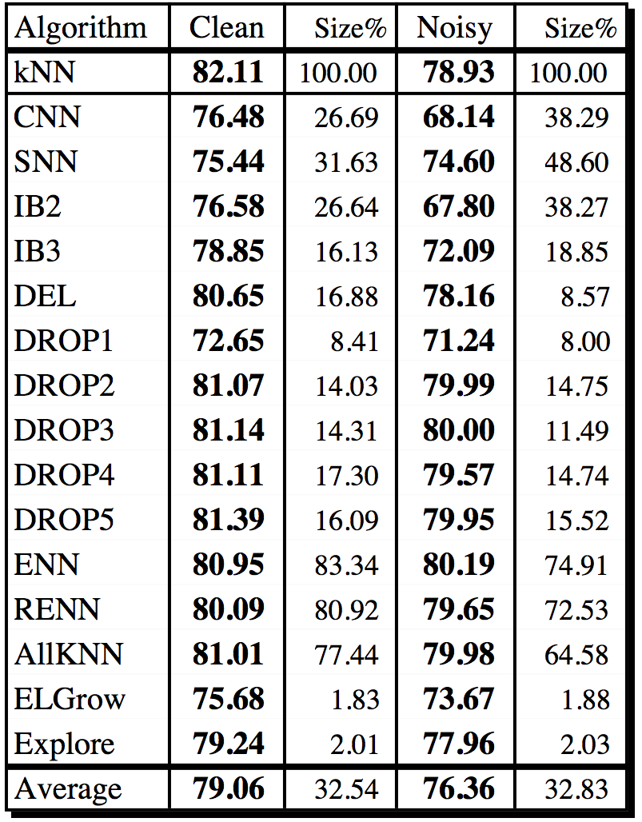
Comparison with other Algorithms

